Slide 1
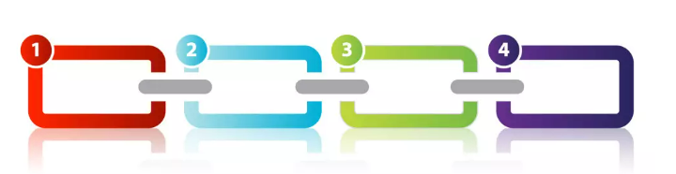
Chain of responsibility Pattern
Amir Dirin Spring 2023

Slide 2
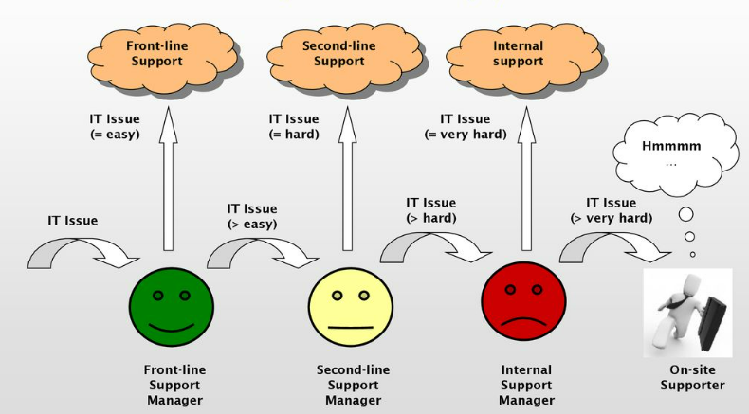
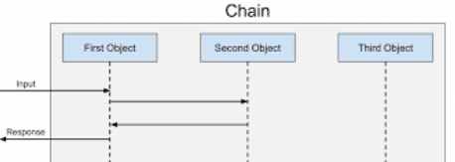
Chain

Slide 3
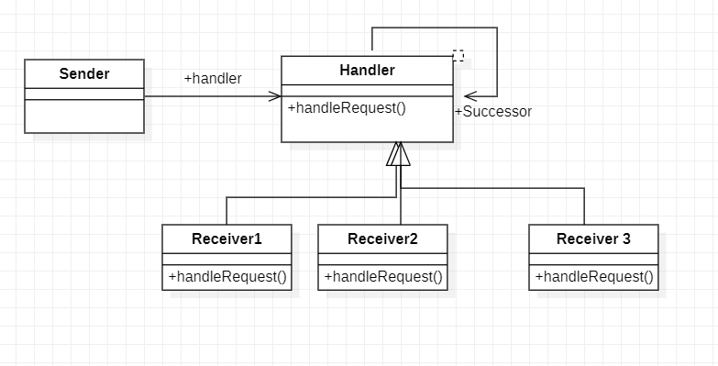
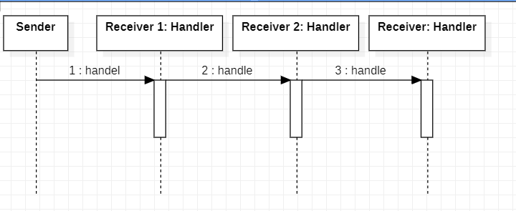
Chain of Responsibility
In chain of responsibility, sender sends a request to a chain of objects.
The request can be handled by an object in the chain.
If one object cannot handle the request then it passes the same to the next receiver and so on.
We send a request to a chain of receivers without having to know which one handle the request.

Slide 4
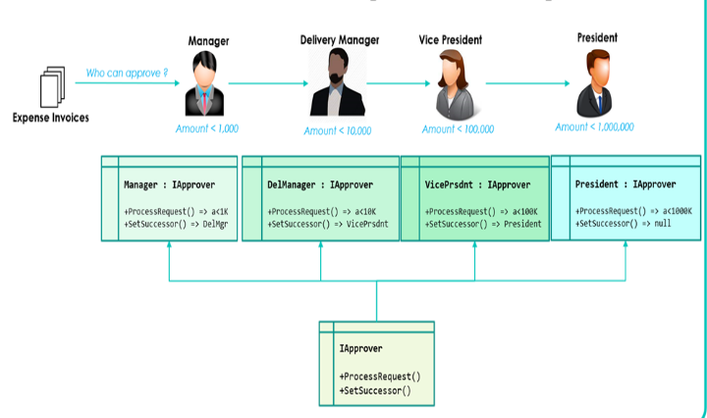
Loan Approval (Lecture Demo)
In a bank where the approval route for mortgage applications are from the bank manager to the director then to the vice president, where the approval limits are
Manger – 0 to 100k
Director – 100k to 250k
Vice president- anything above 250k
We will pass the request to the manager until the application is processed.
Add use case, class and sequence diagrams.

Slide 5
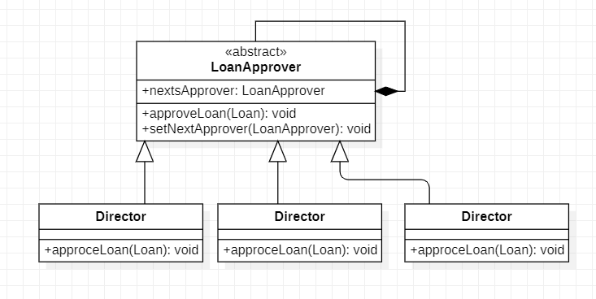
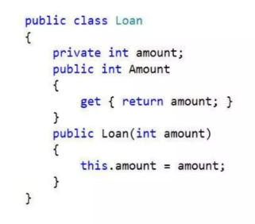
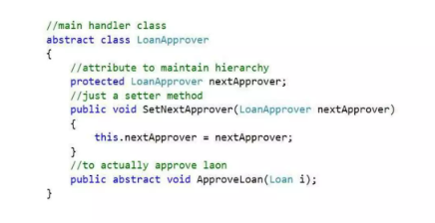
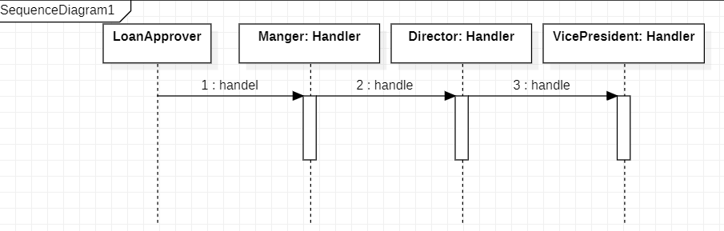
Solution

Slide 6
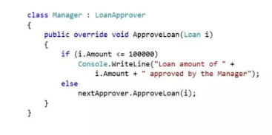
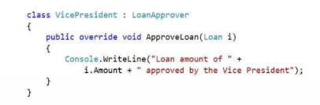
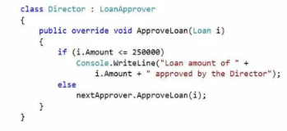
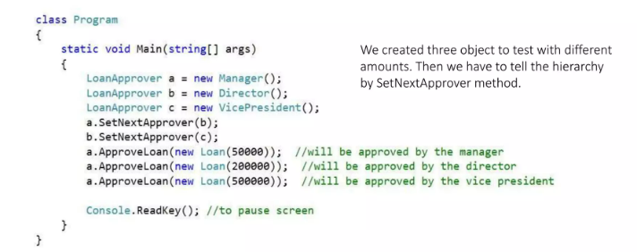
Classes

Slide 7
Lecture Assignment
ATM System to windthrow 20, 50, 100 Euros
Apply for leave 3 days, a week and more then a week
Hotel Room
Security Monitoring System

